Slide 1
Design Patterns

Slide 2
Creational
Abstract Factory
Creates an instance of several families of classes
Builder
Separates object construction from its representation
Factory
Creates an instance of several derived classes
Prototype
A fully initialized instance to be copied or cloned
Singleton
A class of which only a single instance can exist

Slide 3
Structural
Adapter
Match interfaces of different classes
Bridge
Separates an object’s interface from its implementation
Composite
A tree structure of simple and composite objects
Decorator
Add responsibilities to objects dynamically
Façade
A single class that represents an entire subsystem

Slide 4
Structural (contd.)
Flyweight
A fine-grained instance used for efficient sharing
Proxy
An object representing another object

Slide 5
Behavioral
Mediator
Defines simplified communication between classed
Memento
Capture and restore an object’s internal state
Iterator
Sequentially access the elements of a collection
Interpreter
A way to include language elements in a program
Chain of responsibility
A way of passing a request between a chain of objects
Command
Encapsulate a command request as an object

Slide 6
Behavioral (contd.)
State
Alter an object’s behavior when its state changes
Strategy
Encapsulates an algorithm inside a class
Observer
A way of notifying change to a number of classes
Template Method
Defer the exact steps of an algorithm inside a class
Visitor
Defines a new operation to a class without change

Slide 7
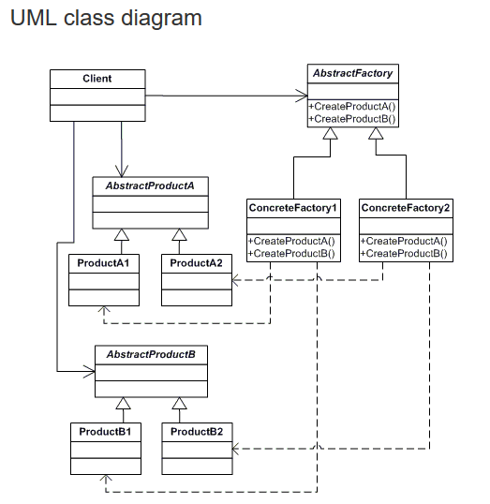
Abstract Factory
Provide an interface for creating families of related or dependent objects without specifying their concrete classes.
Participants
The classes and objects participating in this pattern are:
AbstractFactory (ContinentFactory)
declares an interface for operations that create abstract products
ConcreteFactory (AfricaFactory, AmericaFactory)
implements the operations to create concrete product objects
AbstractProduct (Herbivore, Carnivore)
declares an interface for a type of product object
Product (Wildebeest, Lion, Bison, Wolf)
defines a product object to be created by the corresponding concrete factory
implements the AbstractProduct interface
Client (AnimalWorld)
uses interfaces declared by AbstractFactory and AbstractProduct classes

Slide 8
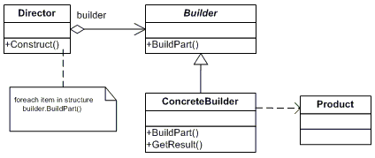
Builder
Separate the construction of a complex object from its representation so that the same construction process can create different representations.
Participants
The classes and objects participating in this pattern are:
Builder (VehicleBuilder)
specifies an abstract interface for creating parts of a Product object
ConcreteBuilder (MotorCycleBuilder, CarBuilder, ScooterBuilder)
constructs and assembles parts of the product by implementing the Builder interface
defines and keeps track of the representation it creates
provides an interface for retrieving the product
Director (Shop)
constructs an object using the Builder interface
Product (Vehicle)
represents the complex object under construction. ConcreteBuilder builds the product's internal representation and defines the process by which it's assembled
includes classes that define the constituent parts, including interfaces for assembling the parts into the final result

Slide 9
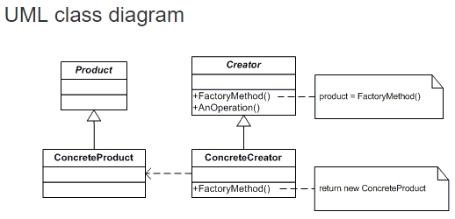
Factory Pattern
Participants
The classes and objects participating in this pattern are:
Product (Page)
defines the interface of objects the factory method creates
ConcreteProduct (SkillsPage, EducationPage, ExperiencePage)
implements the Product interface
Creator (Document)
declares the factory method, which returns an object of type Product. Creator may also define a default implementation of the factory method that returns a default ConcreteProduct object.
may call the factory method to create a Product object.
ConcreteCreator (Report, Resume)
overrides the factory method to return an instance of a ConcreteProduct.
Notes:
VTC

Slide 10
Prototype

Slide 11
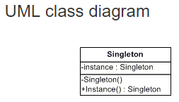
Singleton
Participants
The classes and objects participating in this pattern are:
Handler (Approver)
defines an interface for handling the requests
(optional) implements the successor link
ConcreteHandler (Director, VicePresident, President)
handles requests it is responsible for
can access its successor
if the ConcreteHandler can handle the request, it does so; otherwise it forwards the request to its successor
Client (ChainApp)
initiates the request to a ConcreteHandler object on the chain

Slide 12
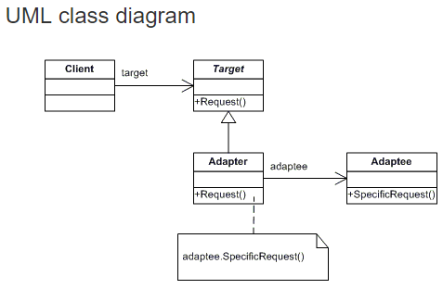
Adapter
Participants
The classes and objects participating in this pattern are:
Target (ChemicalCompound)
defines the domain-specific interface that Client uses.
Adapter (Compound)
adapts the interface Adaptee to the Target interface.
Adaptee (ChemicalDatabank)
defines an existing interface that needs adapting.
Client (AdapterApp)
collaborates with objects conforming to the Target interface.

Slide 13
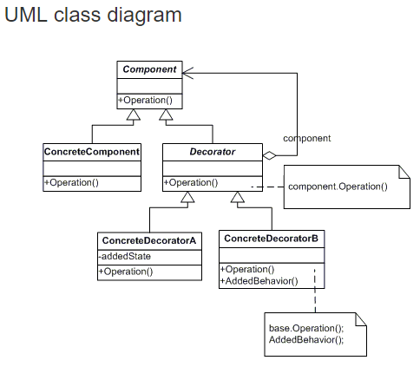
Decorator
Participants
The classes and objects participating in this pattern are:
Component (LibraryItem)
defines the interface for objects that can have responsibilities added to them dynamically.
ConcreteComponent (Book, Video)
defines an object to which additional responsibilities can be attached.
Decorator (Decorator)
maintains a reference to a Component object and defines an interface that conforms to Component's interface.
ConcreteDecorator (Borrowable)
adds responsibilities to the component.
Notes:
Dummies book

Slide 14
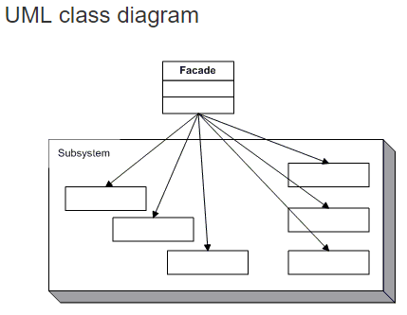
Facade
Participants
The classes and objects participating in this pattern are:
Facade (MortgageApplication)
knows which subsystem classes are responsible for a request.
delegates client requests to appropriate subsystem objects.
Subsystem classes (Bank, Credit, Loan)
implement subsystem functionality.
handle work assigned by the Facade object.
have no knowledge of the facade and keep no reference to it.

Slide 15
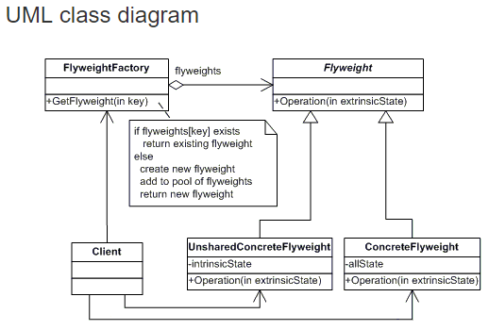
Flyweight
Participants
The classes and objects participating in this pattern are:
Flyweight (Character)
declares an interface through which flyweights can receive and act on extrinsic state.
ConcreteFlyweight (CharacterA, CharacterB, ..., CharacterZ)
implements the Flyweight interface and adds storage for intrinsic state, if any. A ConcreteFlyweight object must be sharable. Any state it stores must be intrinsic, that is, it must be independent of the ConcreteFlyweight object's context.
UnsharedConcreteFlyweight ( not used )
not all Flyweight subclasses need to be shared. The Flyweight interface enables sharing, but it doesn't enforce it. It is common for UnsharedConcreteFlyweight objects to have ConcreteFlyweight objects as children at some level in the flyweight object structure (as the Row and Column classes have).
FlyweightFactory (CharacterFactory)
creates and manages flyweight objects
ensures that flyweight are shared properly. When a client requests a flyweight, the FlyweightFactory objects assets an existing instance or creates one, if none exists.
Client (FlyweightApp)
maintains a reference to flyweight(s).
computes or stores the extrinsic state of flyweight(s)

Slide 16
Proxy
Participants
The classes and objects participating in this pattern are:
Handler (Approver)
defines an interface for handling the requests
(optional) implements the successor link
ConcreteHandler (Director, VicePresident, President)
handles requests it is responsible for
can access its successor
if the ConcreteHandler can handle the request, it does so; otherwise it forwards the request to its successor
Client (ChainApp)
initiates the request to a ConcreteHandler object on the chain

Slide 17
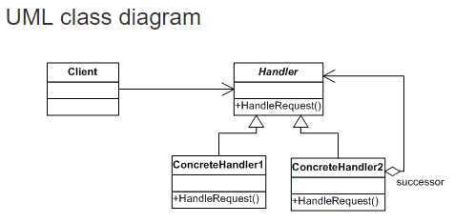
Chain of Responsibility
Participants
The classes and objects participating in this pattern are:
Handler (Approver)
defines an interface for handling the requests
(optional) implements the successor link
ConcreteHandler (Director, VicePresident, President)
handles requests it is responsible for
can access its successor
if the ConcreteHandler can handle the request, it does so; otherwise it forwards the request to its successor
Client (ChainApp)
initiates the request to a ConcreteHandler object on the chain

Slide 18
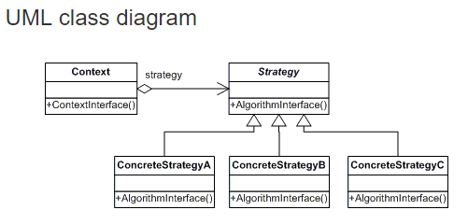
Strategy
Participants
The classes and objects participating in this pattern are:
Strategy (SortStrategy)
declares an interface common to all supported algorithms. Context uses this interface to call the algorithm defined by a ConcreteStrategy
ConcreteStrategy (QuickSort, ShellSort, MergeSort)
implements the algorithm using the Strategy interface
Context (SortedList)
is configured with a ConcreteStrategy object
maintains a reference to a Strategy object
may define an interface that lets Strategy access its data.
Notes:
VTC

Slide 19
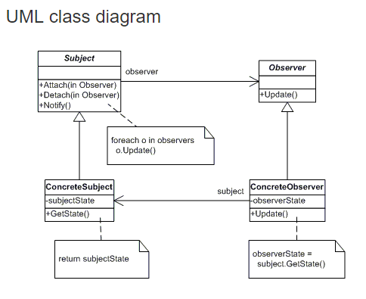
Observer
Participants
The classes and objects participating in this pattern are:
Subject (Stock)
knows its observers. Any number of Observer objects may observe a subject
provides an interface for attaching and detaching Observer objects.
ConcreteSubject (IBM)
stores state of interest to ConcreteObserver
sends a notification to its observers when its state changes
Observer (IInvestor)
defines an updating interface for objects that should be notified of changes in a subject.
ConcreteObserver (Investor)
maintains a reference to a ConcreteSubject object
stores state that should stay consistent with the subject's
implements the Observer updating interface to keep its state consistent with the subject's

Slide 20
Flyweight
Participants
The classes and objects participating in this pattern are:
Handler (Approver)
defines an interface for handling the requests
(optional) implements the successor link
ConcreteHandler (Director, VicePresident, President)
handles requests it is responsible for
can access its successor
if the ConcreteHandler can handle the request, it does so; otherwise it forwards the request to its successor
Client (ChainApp)
initiates the request to a ConcreteHandler object on the chain

Slide 21
Flyweight
Participants
The classes and objects participating in this pattern are:
Handler (Approver)
defines an interface for handling the requests
(optional) implements the successor link
ConcreteHandler (Director, VicePresident, President)
handles requests it is responsible for
can access its successor
if the ConcreteHandler can handle the request, it does so; otherwise it forwards the request to its successor
Client (ChainApp)
initiates the request to a ConcreteHandler object on the chain

Slide 22
Flyweight
Participants
The classes and objects participating in this pattern are:
Handler (Approver)
defines an interface for handling the requests
(optional) implements the successor link
ConcreteHandler (Director, VicePresident, President)
handles requests it is responsible for
can access its successor
if the ConcreteHandler can handle the request, it does so; otherwise it forwards the request to its successor
Client (ChainApp)
initiates the request to a ConcreteHandler object on the chain

Slide 23
Flyweight
Participants
The classes and objects participating in this pattern are:
Handler (Approver)
defines an interface for handling the requests
(optional) implements the successor link
ConcreteHandler (Director, VicePresident, President)
handles requests it is responsible for
can access its successor
if the ConcreteHandler can handle the request, it does so; otherwise it forwards the request to its successor
Client (ChainApp)
initiates the request to a ConcreteHandler object on the chain

Slide 24
Flyweight
Participants
The classes and objects participating in this pattern are:
Handler (Approver)
defines an interface for handling the requests
(optional) implements the successor link
ConcreteHandler (Director, VicePresident, President)
handles requests it is responsible for
can access its successor
if the ConcreteHandler can handle the request, it does so; otherwise it forwards the request to its successor
Client (ChainApp)
initiates the request to a ConcreteHandler object on the chain

